Slide 1
Foundations Of Data Analytics – CSE3505
Niranjan J
19MIA1003

Slide 2
Loan Approval Prediction

Slide 3
S.No | Topic | Answers
1 | Claims made | Build a Neural Network model
2 | Percentage of completion | 100% project completed
3 | Contribution of team members | Single member in team (100%)
4 | GitHub link | https://github.com/Niranjan1112/FDA-Project
5 | Wheather ppt and report uploaded in LMS | yes

Slide 4
Abstract
Account firms and banks need to automatize the credit qualification activity (continuously) essentially dependent on data given by customers when rounding out an online structure. The attributes include Sex, Marital Status, Education, Number of Dependents, Salary, Loan Amount, Credit History, and different subtleties are incorporated.To digitize this interaction, they made an issue to group the client sections that can apply for a credit sum, permitting them to focus on these clients explicitly. They have introduced a fractional informational collection for this situation. Approval of Loan is a very common real-life problem that every company faces in their lending operations. If the loan approval process is automated, it can save a lot of man hours and improve the speed of service to the customers. The
increase in customer satisfaction and savings in operational costs are significant. However, the rewards can only be realised if the bank has a sturdy model in place to accurately forecast which client's loans it should accept and which it should reject, in order to reduce potential risk. In this project 3 algorithms of classification based machine learning will be applied, that is Decision tree, Random Forest Classifier and Naive Bayes to predict the loan approval with large accuracy. By implementation of this project we will be able to predict and ensure that applicant for the loan is safe or not by this loan approval prediction system.

Slide 5
Problem Statement
Account firms and banks need to automatize the credit qualification activity (continuously) essentially dependent on data given by customers when rounding out an online structure. The attributes include Sex, Marital Status, Education, Number of Dependents, Salary, Loan Amount, Credit History, and different subtleties are incorporated.
To digitize this interaction, they made an issue to group the client sections that can apply for a credit sum, permitting them to focus on these clients explicitly. They have introduced a fractional informational collection for this situation.
Approval of Loan is a very common real-life problem that every company faces in their lending operations. If the loan approval process is automated, it can save a lot of man hours and improve the speed of service to the customers. The increase in customer satisfaction and savings in operational costs are significant. However, the rewards can only be realised if the bank has a sturdy model in place to accurately forecast which client's loans it should accept and which it should reject, in order to reduce potential risk.

Slide 6
Literature Survey
Vaidya had suggested a method for approving loan forecasts using logistic regression. Logistic Regression is one of the most popular and very useful classification based algorithm. The purpose or the importance of using Logistic Regression was that it uses the concept of predictive analysis which was suitable enough for describing the data.
M. Bayraktar et al. proposed a method for credit risk analysis using machine learning. Boltzman machine was used to make the analysis for risk calculation of loan.
Y. Shi and P. Song proposed a method for evaluating project loans using risk analysis. The method evaluate the risk involved in loans of commercial banks.
V. C. T. Chan et al. proposed a credit approval system using web-services. For clients loan as approved by the system. The consumer provides extra relevant information with the credit application. This information’s are processed by Credit Approval System which finally give credit score to the applicant. After going through this, Machine learning algorithm are very helpful in predicting outcomes even when the data is huge in size.

Slide 7
Objective
Banking system have large number of products to earn profit, but their vital source of income is from its credit system. Because Credit system can earn from interests of that loans which they credit. Banking system always need accurate modelling system for large number of issues.
The prediction of credit defaulters is one of the difficult task for anybank.But by forecasting the loan defaulters, the banks definitely may reduce its loss by reducing its non-profit assets,so that recovery of approved loans can take place without any loss and it can play as the contributing parameter of the bank statement. This makes the study of this loan approval prediction important.
Machine Learning techniques are very crucial and useful in prediction of these type of data. In this project 3 algorithms of classification based machine learning will be applied, that is Decision tree, Random Forest Classifier and Support Vector Machine to predict the loan approval with large accuracy. By implementation of this project we will be able to predict and ensure that applicant for the loan is safe or not by this loan approval prediction system.

Slide 8
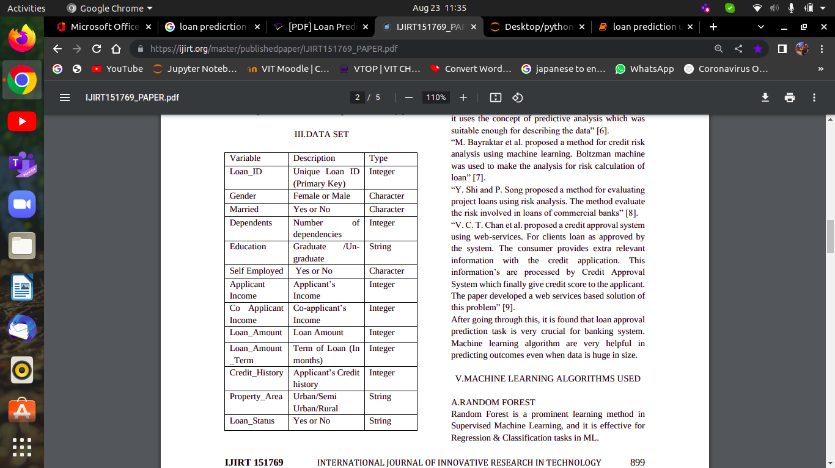
Dataset

Slide 9
Dataset description
- Loan_ID : Unique Loan ID
- Gender : Male/ Female
- Married : Applicant married (Y/N)
- Dependents : Number of dependents
- Education : Applicant Education (Graduate/ Under Graduate)
- Self_Employed : Self employed (Y/N)
- ApplicantIncome : Applicant income
- CoapplicantIncome : Coapplicant income
- LoanAmount : Loan amount in thousands of dollars
- Loan_Amount_Term : Term of loan in months
- Credit_History : credit history meets guidelines yes or no
- Property_Area : Urban/ Semi Urban/ Rural
- Loan_Status : Loan approved (Y/N) this is the target variable

Slide 10
Algorithms
The Machine learning algorithms used are :
(1) Decision Tree –
This algorithm is a non-parametric supervised machine learning algorithm. It can also be used for both classification and regression, although it is more widely used for classification technique. It works with categorical and continuous variables.

Slide 11
Random Forest
(2) Random Forest is a prominent learning method in Supervised Machine Learning, and it is effective for Regression & Classification tasks in ML. It generates random forests and then uses these random forests to seek the solutions. It is an ensemble learning in which significant number of classifiers are used to solve a complex problem. Random forest analyzes each tree for prediction rather than just one to avoid overfitting issues. The greater the number of trees, the greater the accuracy in problem solving.

Slide 12
Naive Bayes Classifier
(3) The Naive Bayes classification algorithm is probabilistic classifier. It is based on probability models that incorporate strong independence assumptions. The independence assumptions often do not have an impact on reality. Therefore, they are considered as naive.

Slide 13
Novelty
The novelty of this project is to build a MultiLayer Perceptron model. Then we will compare the MLP model with the classification models like Random forest, Naive bayes and Decision tree.

Slide 14
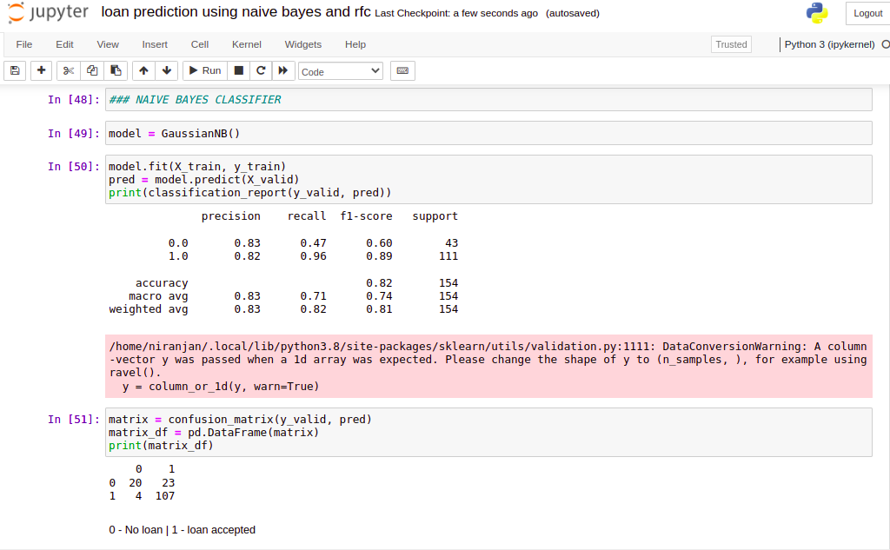
Implementation

Slide 15
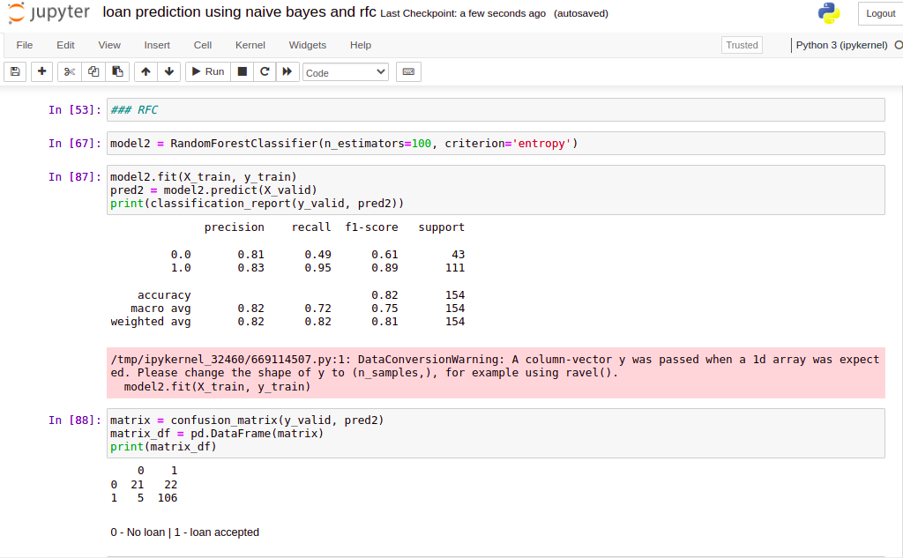

Slide 16
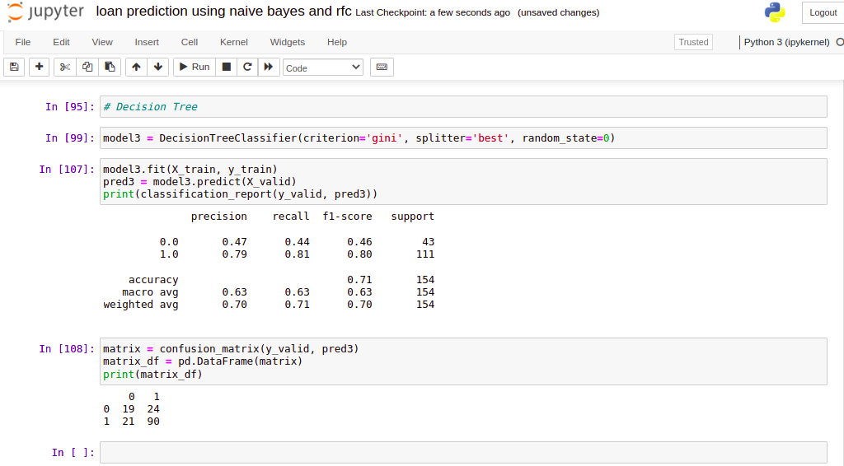

Slide 17
Project Pipeline
The project pipeline steps include:
- Importing libraries
- Reading dataset
- Preprocessing dataset (imputation and encoders)
- Splitting dataset into training and testing
- Building model for classification
- Model evaluation and accuracy
- Comparing built machine learning models

Slide 18
Conclusion
In this project, machine learning was used to predict loan acceptance. The prediction method begins with data pre-processing, filling the missing values, experimental data analysis. After evaluating model on test dataset, each of these algorithms obtained a precision rate between 75% and 85%. We will next build a Neural Network model for this project as a future work.

Slide 19
References
https://www.semanticscholar.org/paper/Loan-Prediction-by-using-Machine-Learning-Models-Supriya-Pavani/54646ad5279f94bb717dd57263da4cf360a9a8c8#paper-header
https://ieeexplore.ieee.org/document/9155614
https://www.ijert.org/predict-loan-approval-in-banking-system-machine-learning-approach-for-cooperative-banks-loan-approval
https://ijirt.org/master/publishedpaper/IJIRT151769_PAPER.pdf

Slide 20
GitHub Link
https://github.com/Niranjan1112/FDA-Project

Slide 21
Thank you

